Slide 1

Water Resource Management System
B.Tech-CE Semester- VIII
Prepared at
ISO 9001:2008
ISO 27001:2013
CMMI LEVEL-5
Bhaskaracharya Institute for Space Applications & Geo-informatics
Science & Technology Department, Govt. of Gujarat.
Gandhinagar
Internal Guide: Prof. Mrudang Mehta
External Guide: Vishal Patel
Developed By:-
Shail Shah(CE-116)
Vidhi Sagathiya(CE-103)
Krupa Shah(CE-110)

Slide 2
Overview
Introduction
System Architecture
System Analysis, Design, Screenshots and
Testing
Limitations, Conclusion and Future goals

Slide 3
Introduction
What is lacking in existing systems?
Why new system is needed?
MAIN OBJECTIVE
To provide an automate manner of activities right from managing the information of water resources to handling user Complains and Donations.

Slide 4
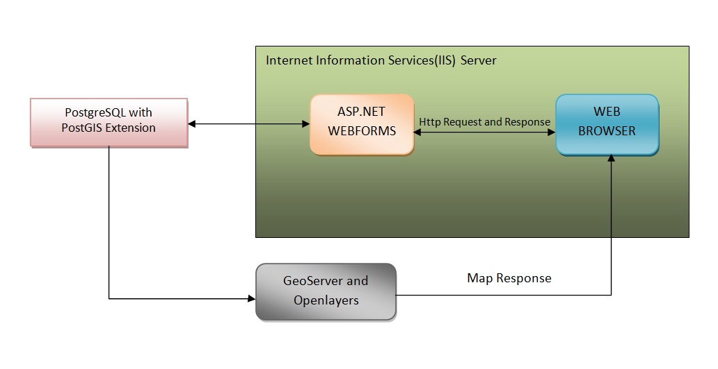
System Architecture

Slide 5
System Analysis, Design, Screenshots and Testing

Slide 6
Main Modules
Admin
Can Manage Resources.
Can Handle Complaints
Can Upload Files.
Can View Donations.
User
Can Get Information.
Can Register Complaint.
Can Donate Fund.
Can Download Files.
Can View News.

Slide 7
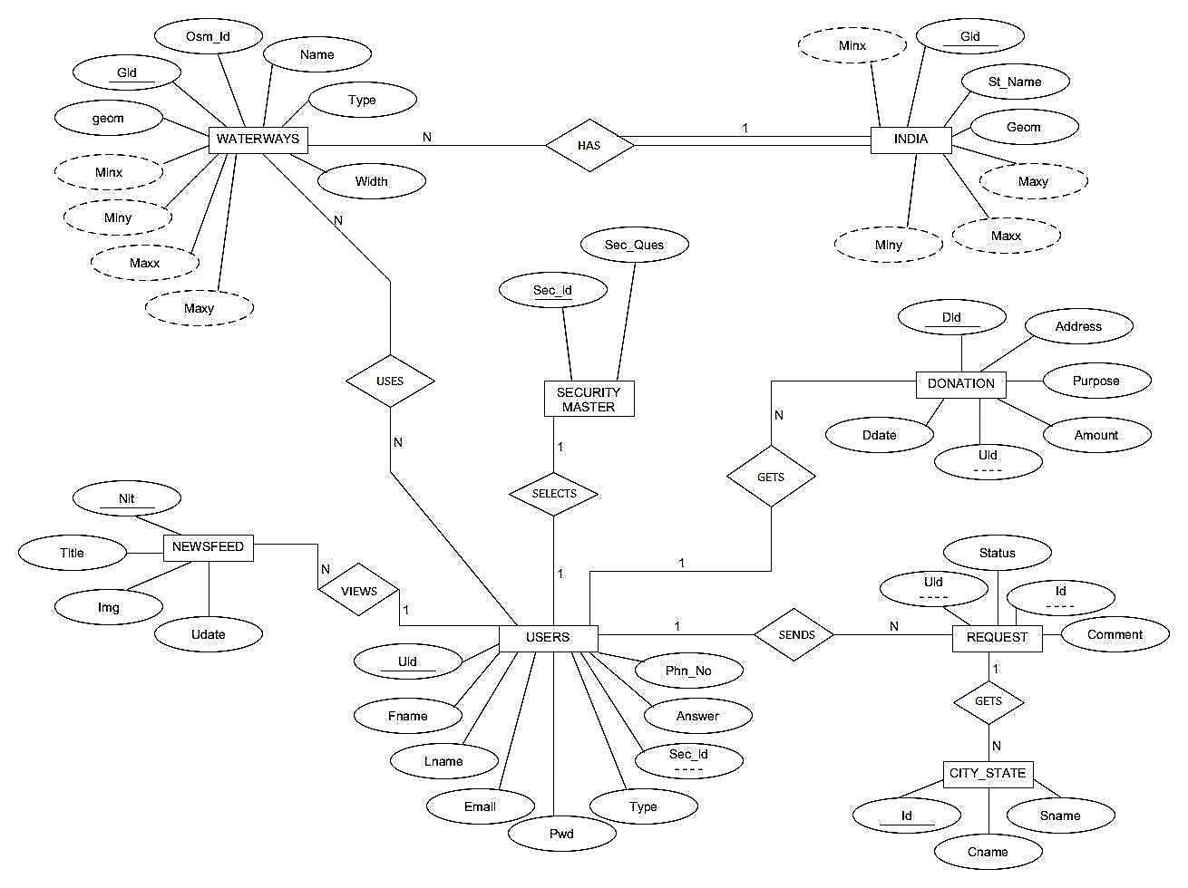
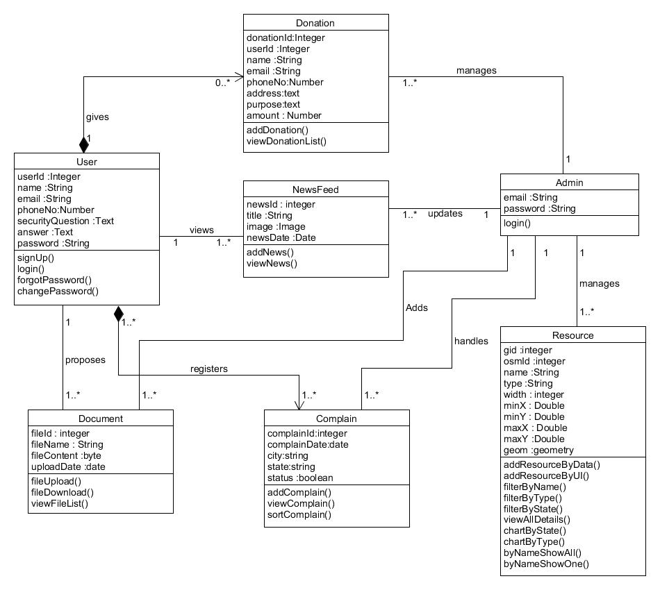
ER Diagram

Slide 8
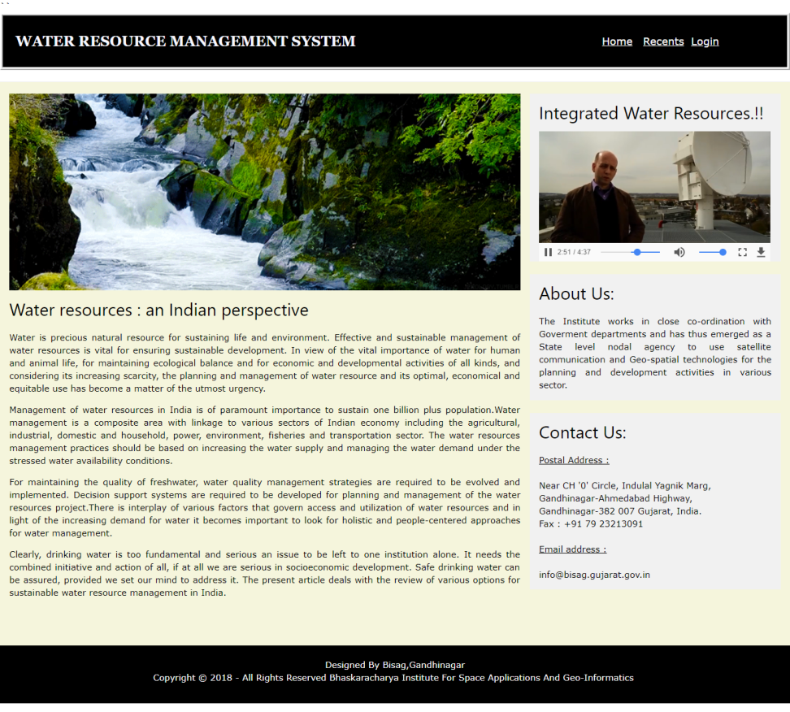
Home Page

Slide 9
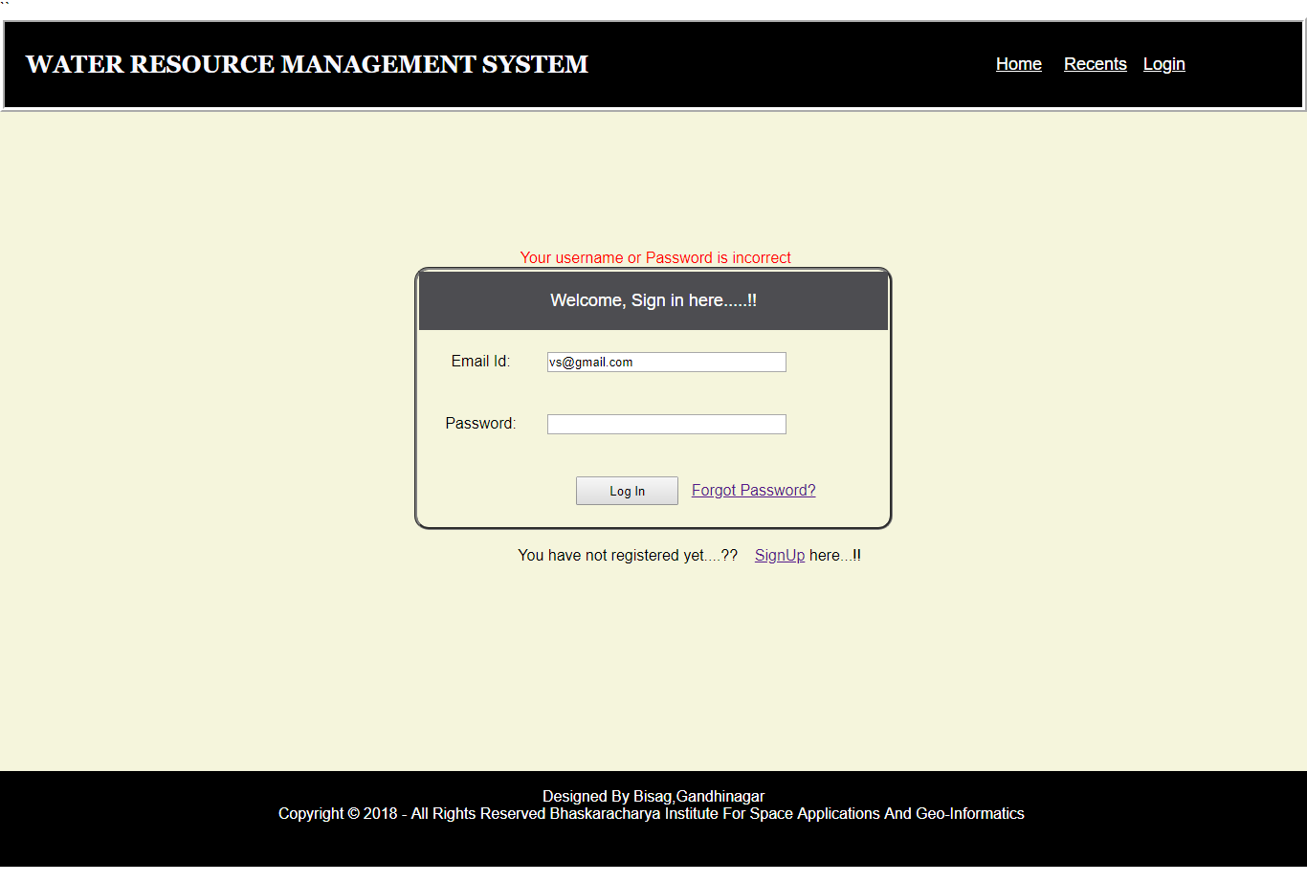
Login Page and Test Cases
Valid email and password
Invalid email and valid password
Valid email and invalid password
Invalid email and password

Slide 10
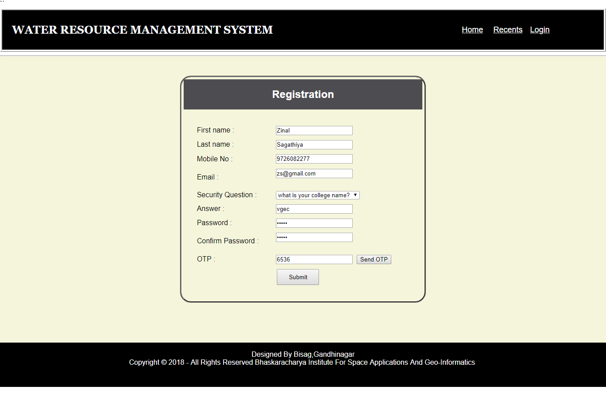
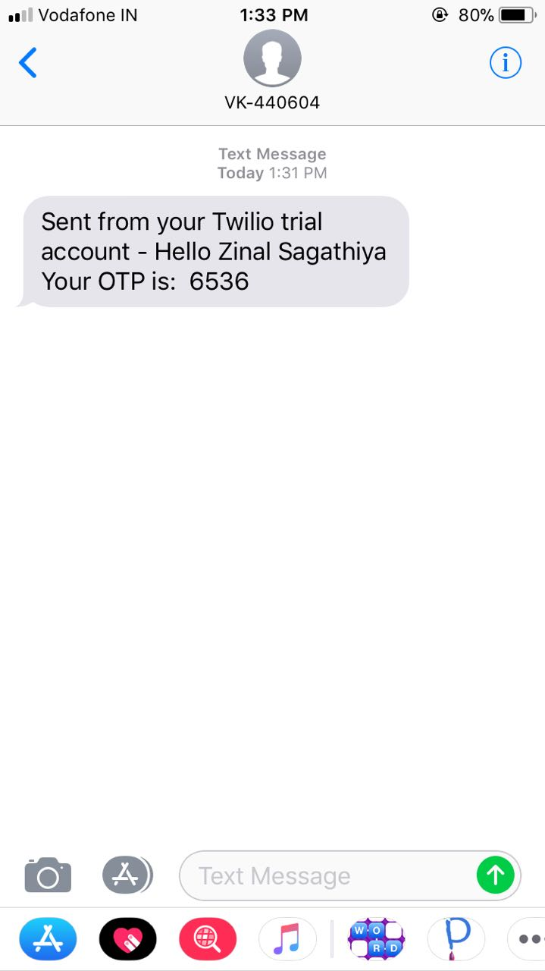
Registration Page
Sign Up Form
OTP Received

Slide 11
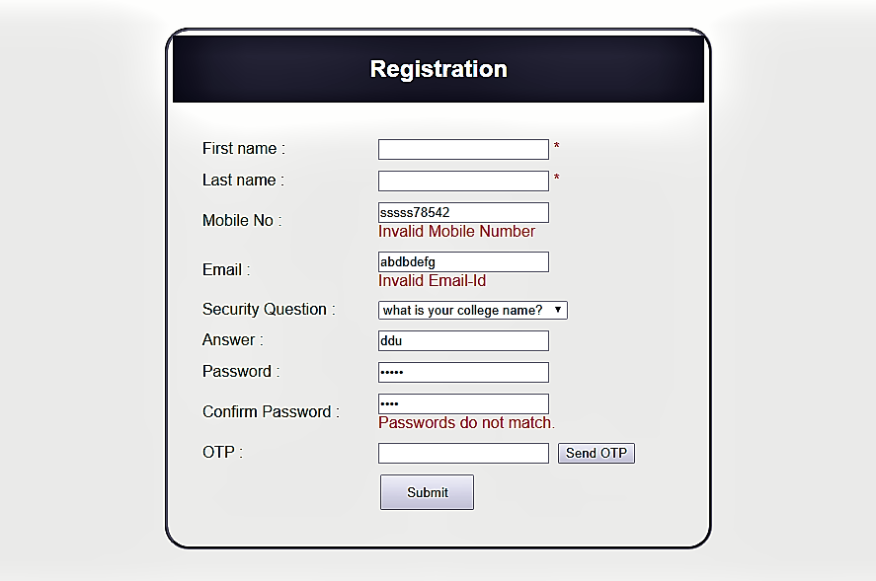
Registration Page Validation

Slide 12
Registration Page Test Cases
Input | Expected Result | Test Result
1. Enter valid information | Site should display Dashboard | As expected
2. Enter invalid mobile number | Site should display Error Message Invalid mobile number | Error Message Shown
3. Enter invalid Email id | Site should display Error Message Invalid email id | Error Message Shown
4. Without entering few/any information | Site should display Error Message field is required | Error Message Shown

Slide 13
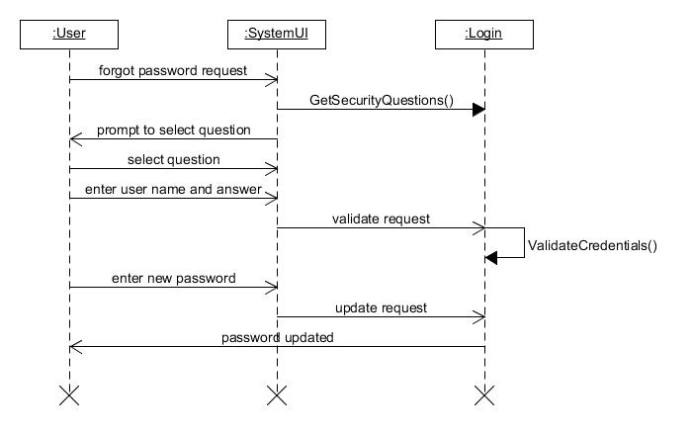
Sequence Diagram for Forgot Password

Slide 14
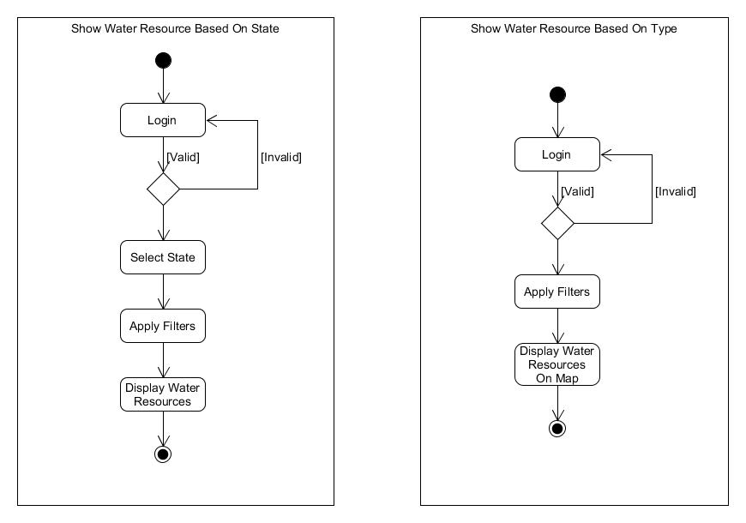
Activity diagram for Showing Resource based on state/type

Slide 15
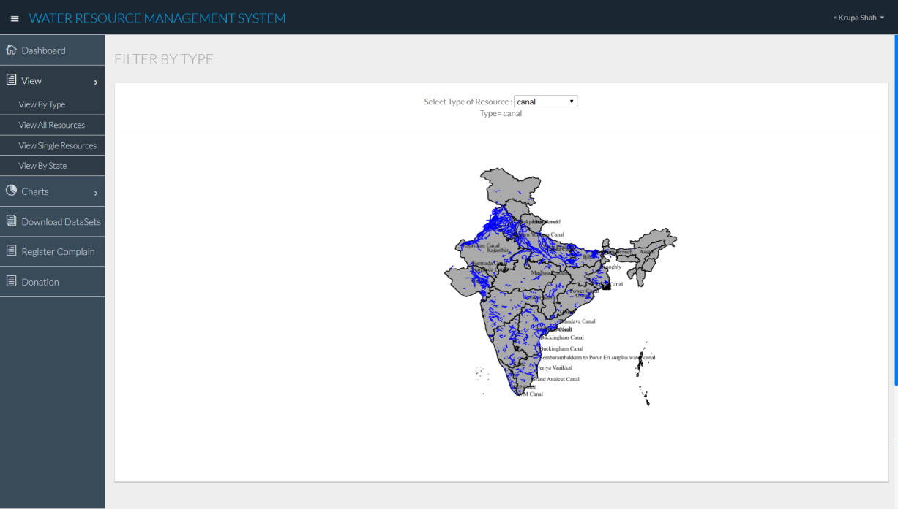
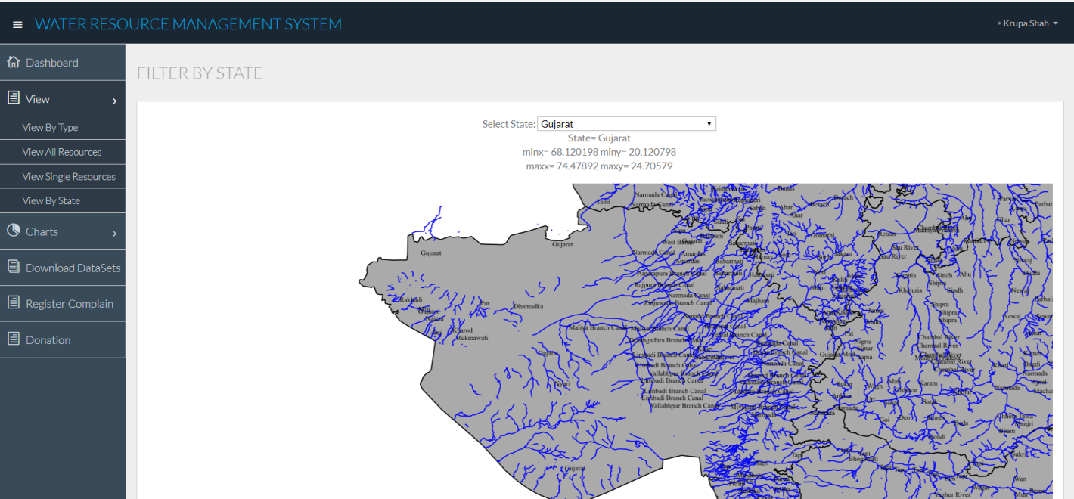
Screenshots Showing Resource based on state/type
<-By Type
By State->

Slide 16
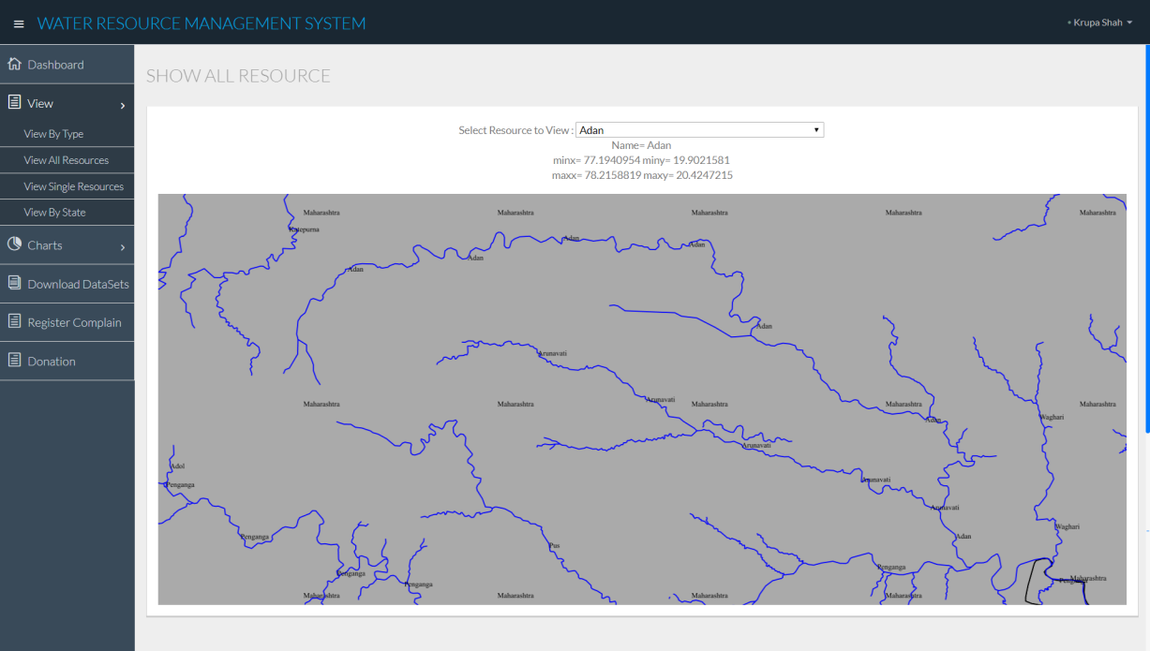
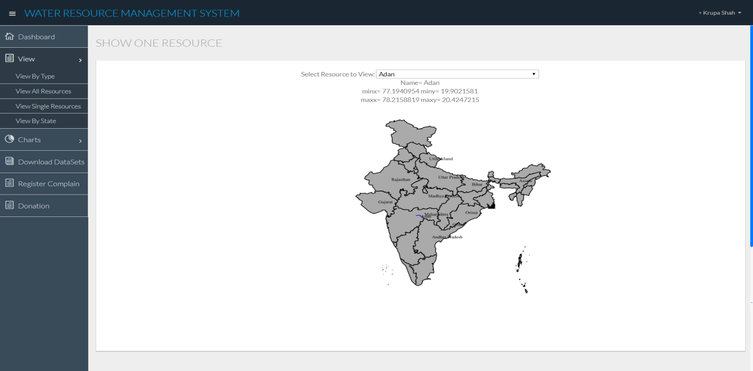
Screenshots Showing Single and All Resource
<-Show All
Show Single->

Slide 17
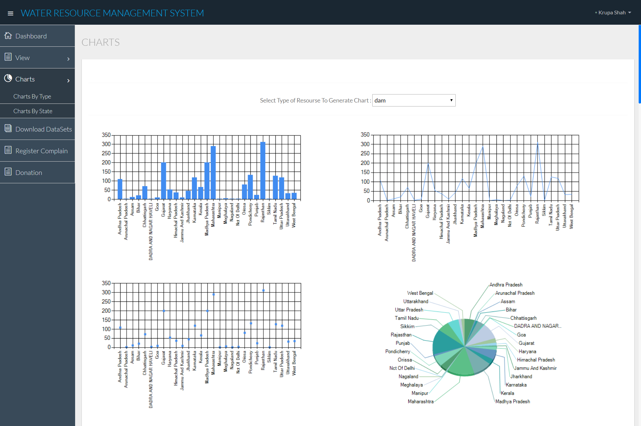
Chart Based On Type

Slide 18
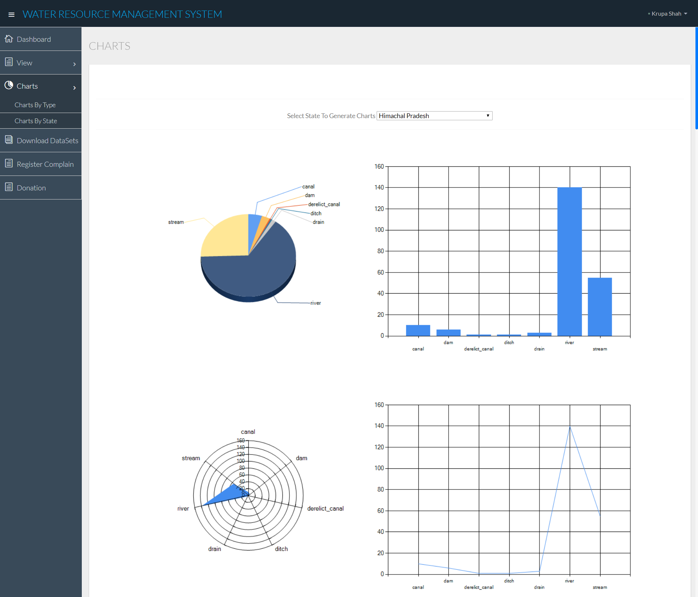
Chart Based On State

Slide 19
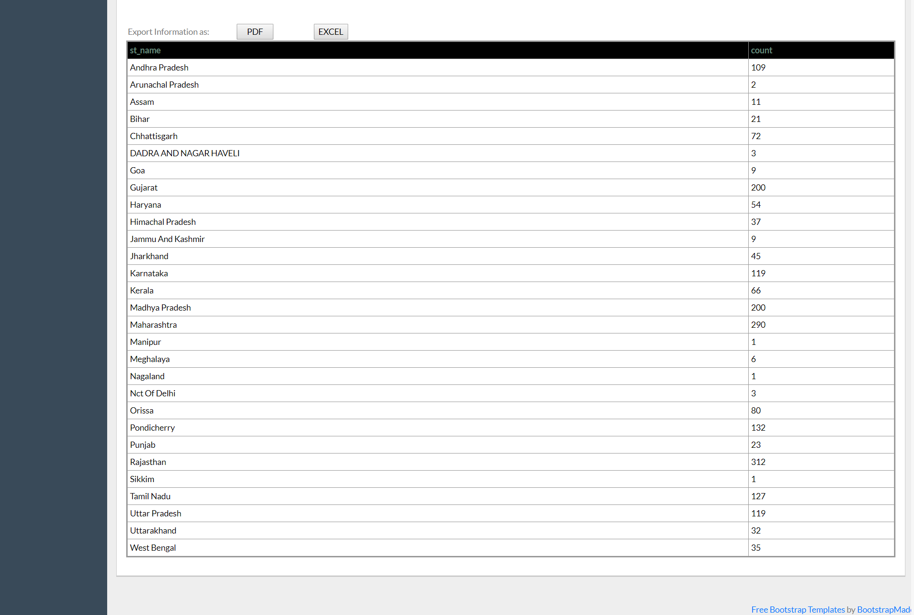

Slide 20
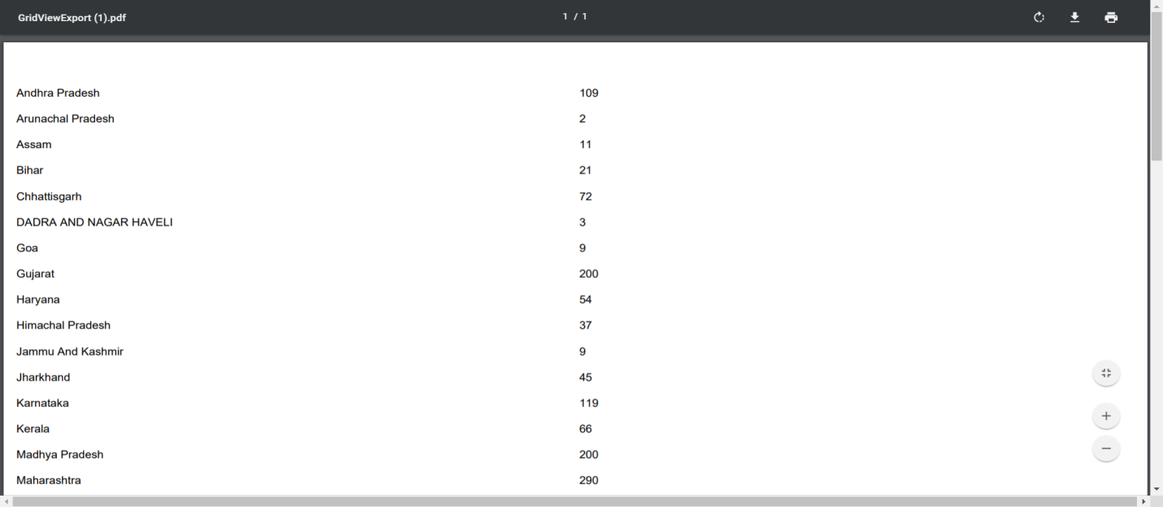
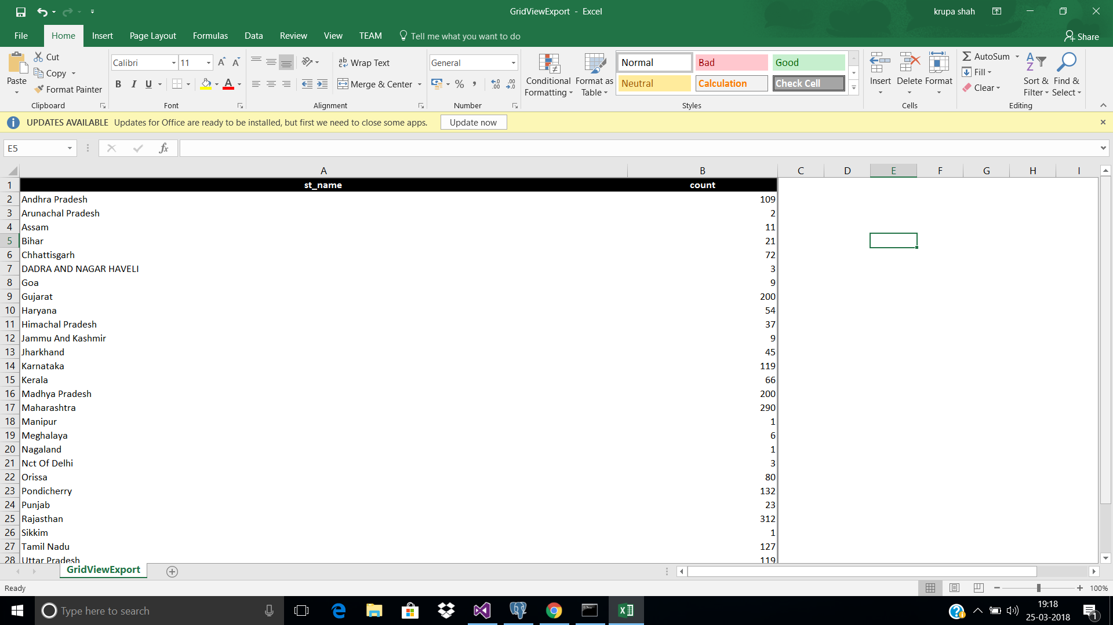
All the Tabular data Can be Downloaded in either .pdf and .xls
<- .pdf File
.xls File->

Slide 21
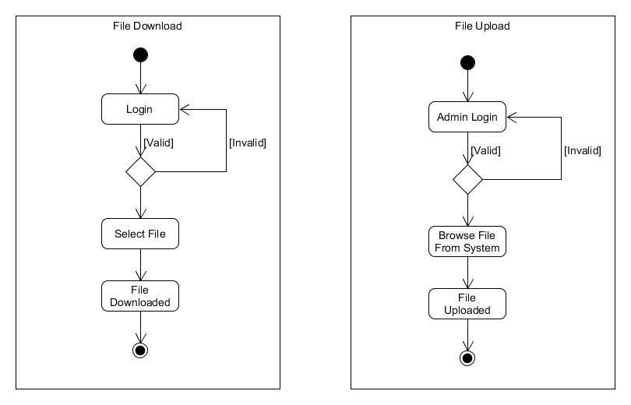
Activity diagram for file Download and Upload
Test case for : | File Upload | 1. Select file with size less than 100 Mb | Site should Upload the file | As expected
 |  | 2. Select file with size more than 100 Mb | Site should Upload the file | Error Message Shown

Slide 22
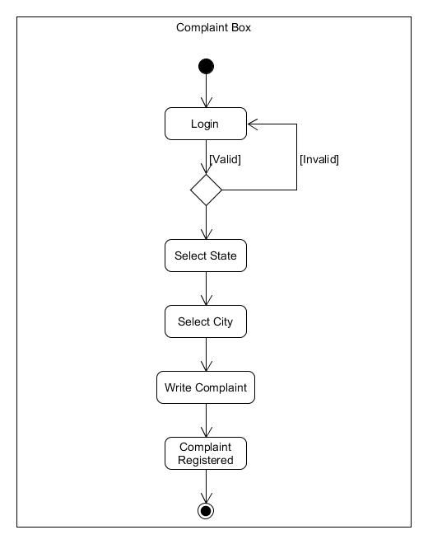
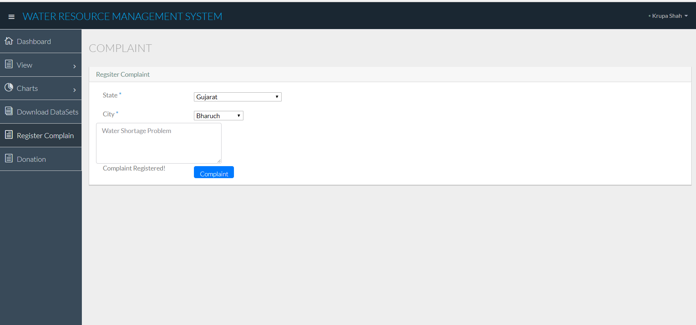
Complaint Page
Activity Diagram
Screenshot

Slide 23
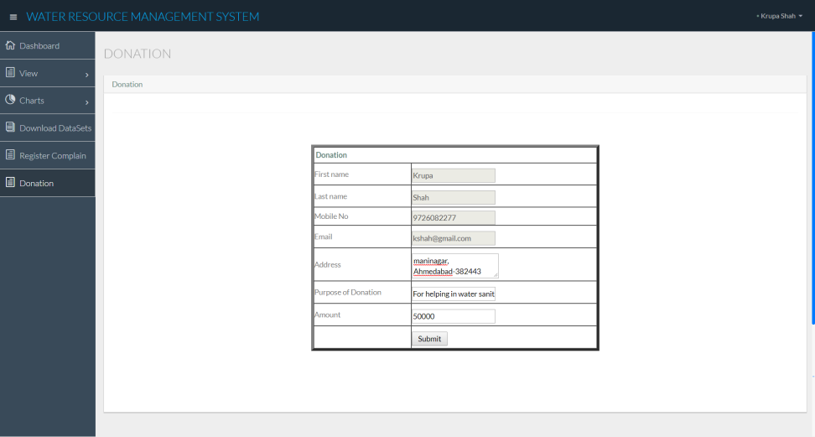
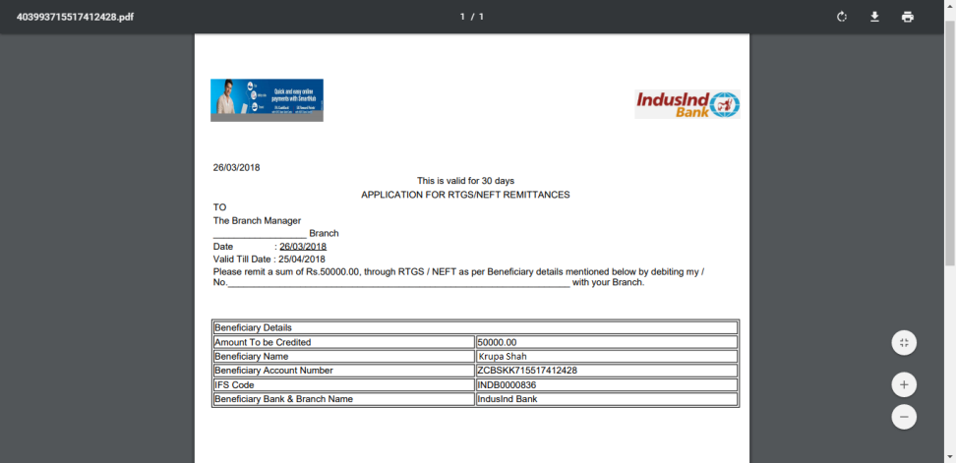
Donation Page
<-Payment Form
Payment Receipt->

Slide 24
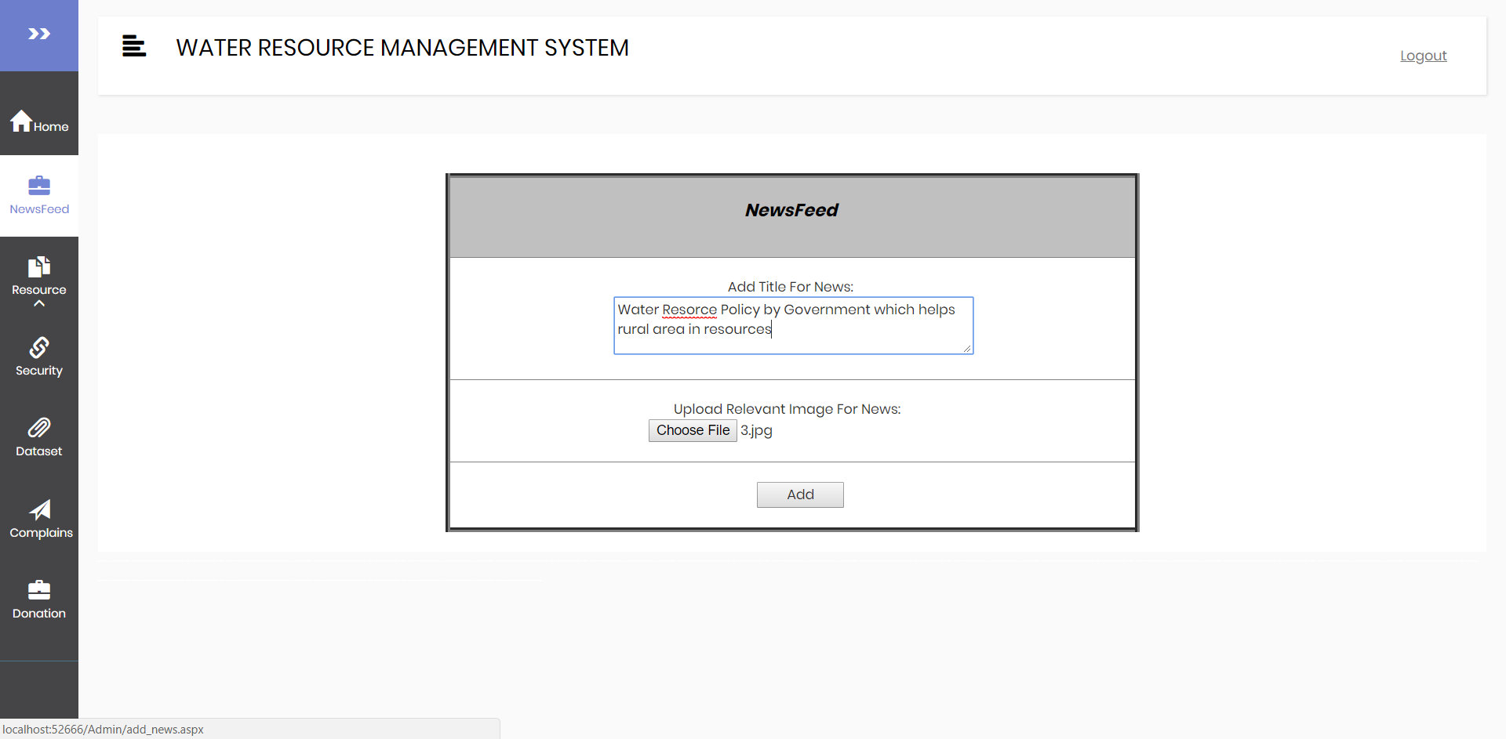
Form to add NewsFeeds

Slide 25
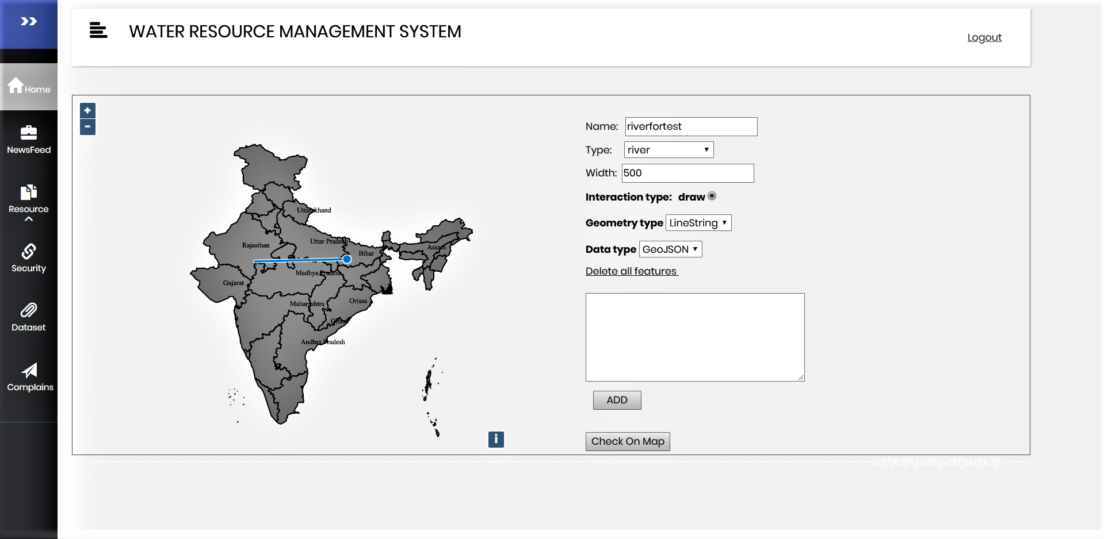
Add Resource by UI

Slide 26
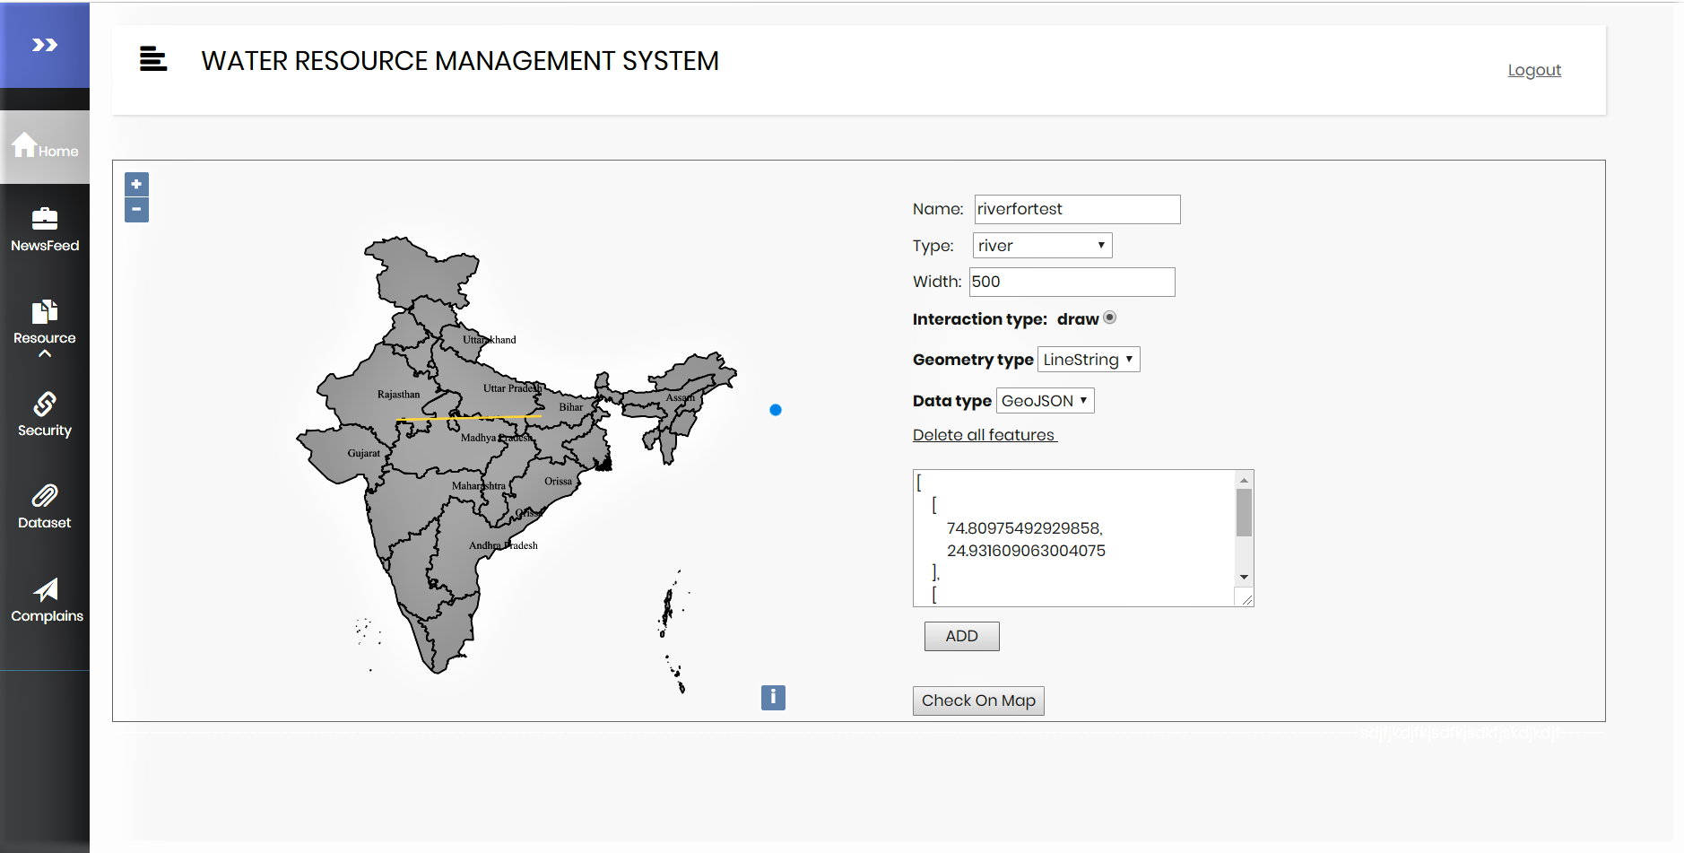
Add Resource by UI

Slide 27
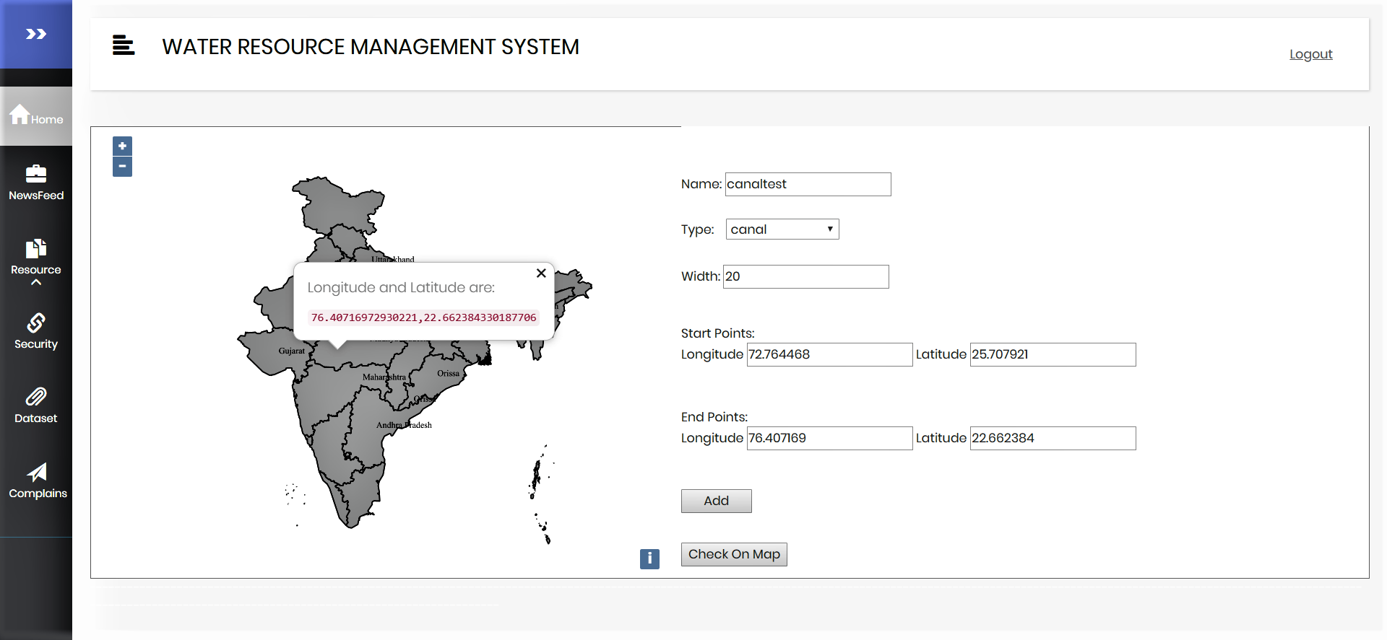
Add Resource by Data

Slide 28
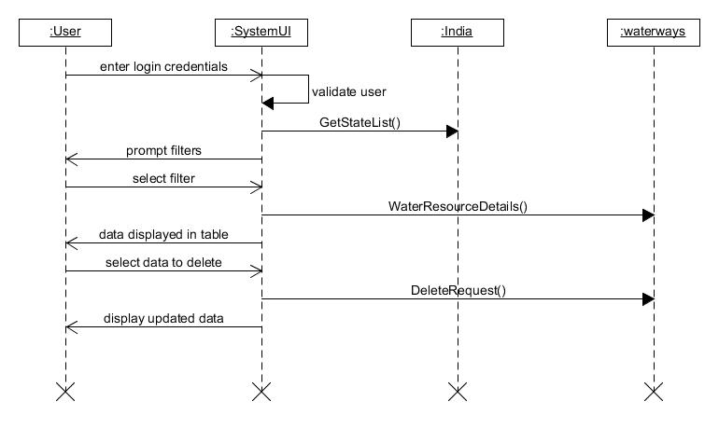
Sequence Diagram for Delete Resource

Slide 29
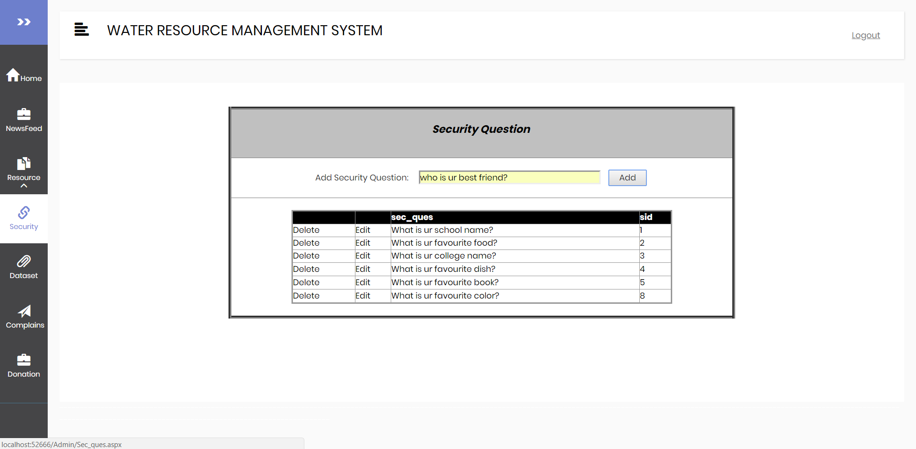
Add Security Questions

Slide 30
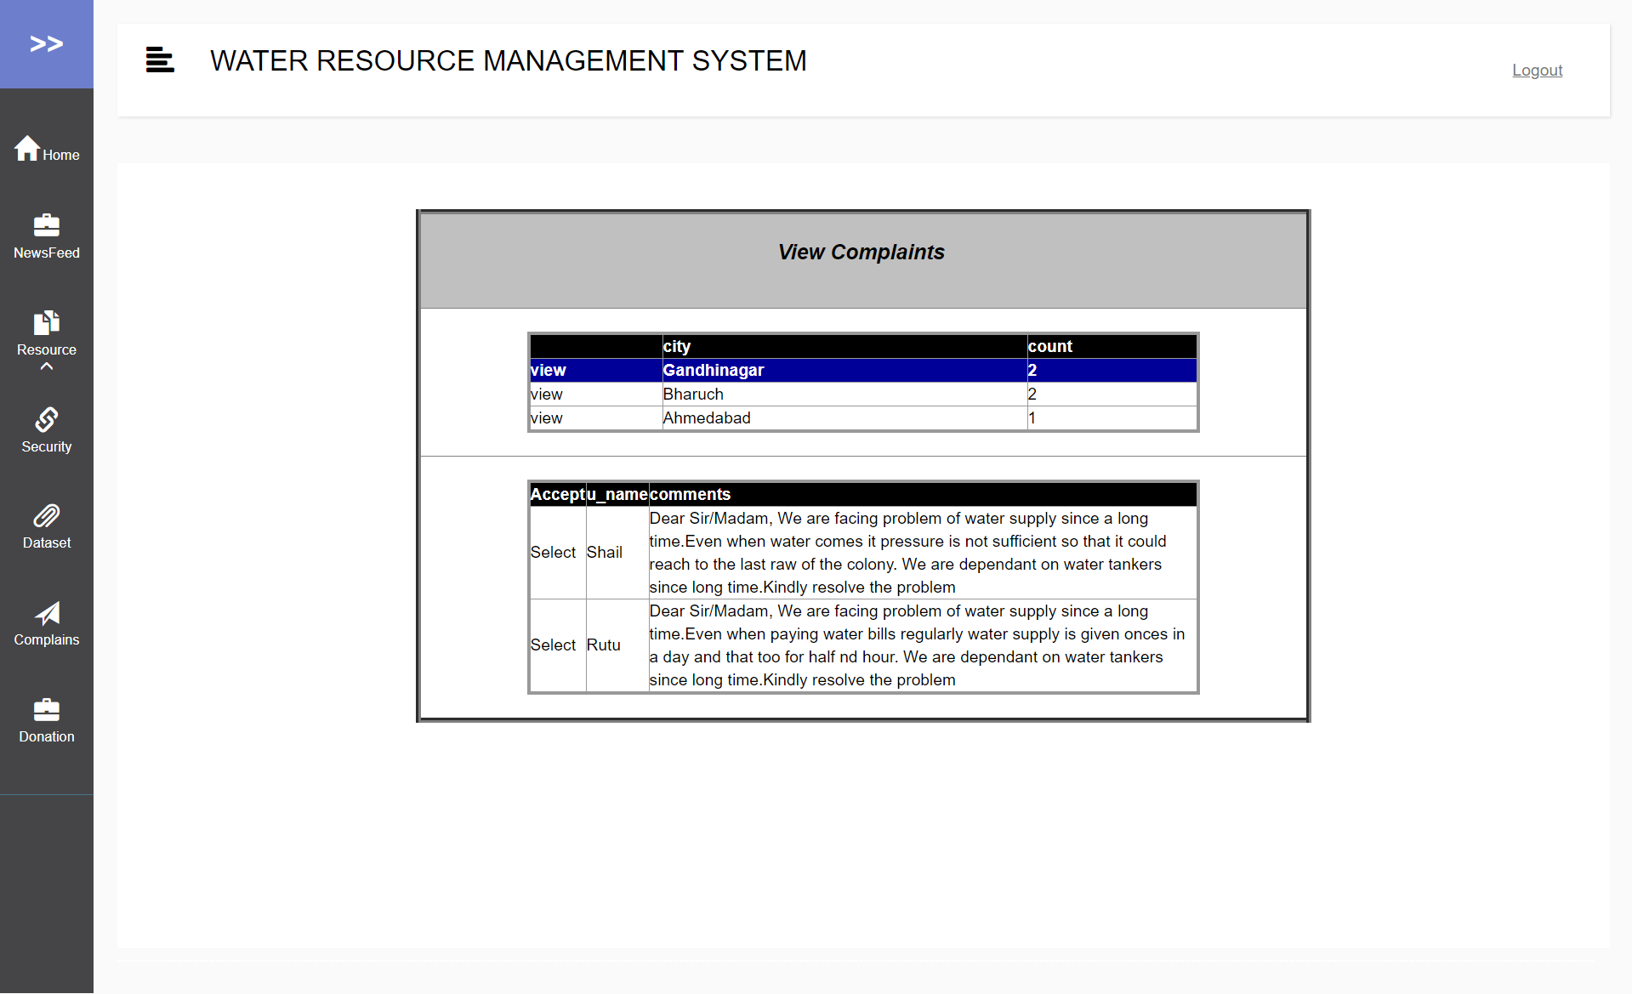
View Complaints

Slide 31
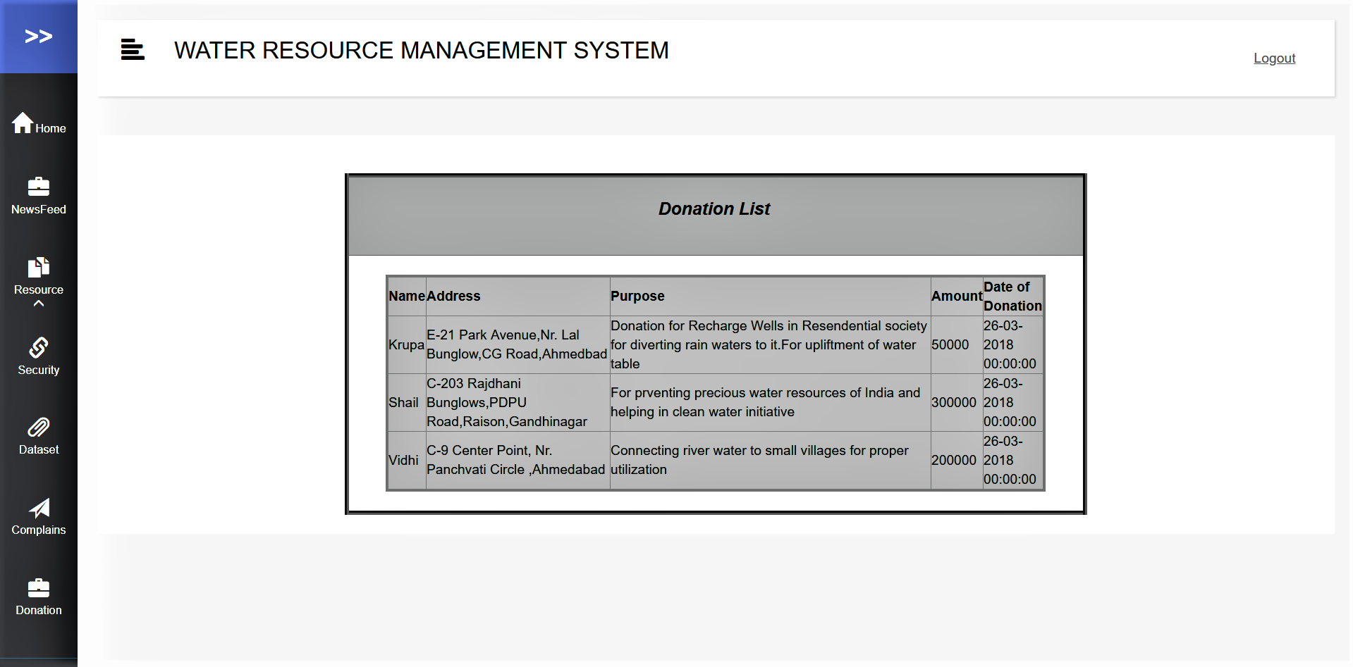
View Donations

Slide 32
Limitations, Conclusion and Future Goals

Slide 33
Thank You!

